Slide 1

SAP BTP ABAP on Cloud / RAP Training
DAY-5
Anubhav Oberoy
www.AnubhavTrainings.com
Follow excellence with sheer passion

Slide 2


DISCLAIMER
The training content and delivery of this presentation is confidential, and cannot be recorded, or copied and distributed to any third party, without the written consent of Anubhav Trainings

Slide 3

01
RAP Scenario
02
Managed RAP
03
Business Scenario
04
Development of BO and Read only App
Notes:
https://pixabay.com/photos/san-francisco-transamerica-pyramid-1633203/

Slide 4

Types of Implementation (Scenario)
Brownfield Implementation
Is used when we want to create a transactional application which can insert, update, delete data from the system by writing your own logic
You already have Business logic with you and you want to use that business logic to perform transactional capability
You are own your own to manage your implementation.
02. Managed Scenario
Greenfield Implementation
Is used when we want to create a transactional application which can insert, update, delete data from the system by using the framework provided implementation
You do not have Business logic with you and you want system to create business logic for you automatically.
01. Un-Managed Scenario
www.anubhavtrainings.com

Slide 5
Managed RAP implementation
The managed RAP implementation addresses use cases where all the essential parts of the applications are to be developed from scratch. However, these new applications can highly benefit from out-of-box support for transactional processing. Standard operations like create, update, delete must only be specified in the behavior definition to obtain a ready-to-run business object. The provisioning of transaction buffer is also done automatically for us by the framework. The interaction phase and save sequence are also implemented generically. The application developer can focus on business part of app like adding custom validation, actions, determinations. The RAP transaction engine manages the life cycle of our Business object and covers all the aspects of our app development.
The managed implementation type is aimed for building new applications from scratch without having any prior coding exist. The standard functionality that given in managed business objects is easily retrieved. The business logic implemented using predefined implementation methods that are integrated during the runtime in the interaction phase and save sequence.
www.anubhavtrainings.com

Slide 6



Business use case
We will implementing 2 different applications on travel data model. These applications will target different user groups. We will manage the travel requests and booking through our applications which are booked by agency for customer.
Processor – a processor is an employee of our company who will request a new travel plan through the application. He/she will be allowed to create, update, delete, copy travel requests including bookings and supplements. They have full control to manage their travel.
Approver – an approver is a manager who will only be able to view the travel requests created by employees, and can only change the booking fees and approval status of the request (approve/reject).
MakeMyTrip.com- processor app
Processor needs to create, update, delete a travel request through agency including all bookings and supplements
Approval App
The manager would review the travel requests created by processor, can only change the booking fees and approve or reject the travel request
www.anubhavtrainings.com

Slide 7
Understanding projection
If we ever get requirement in our company to develop a use case where we want to reuse the data model (e.g. sales, purchase, accounting, finance) but develop many applications. We will go with RAP and projections. A projection takes part of the base functionality according the needs to user. This will reduce effort, increase reusability in our app.
www.anubhavtrainings.com

Slide 8
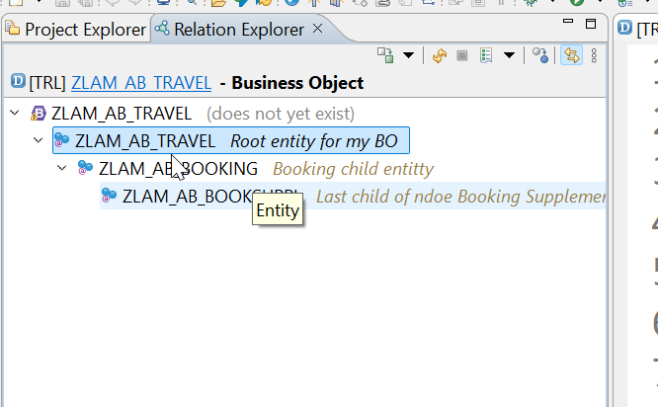


Business Object Definition
From structural point of view, a business object consists of a tree of entities (cds) that are linked in compositions. Every entity in this composition tree is an element that is modeled with CDS view entities. For our demo travel scenario we will implement 3 level composition tree.
/dmo/travel_m
(root entity)
1..N
Business Object
/dmo/booking_m
(child entity)
1..N
/dmo/bookingsuppl_m
(child entity)
www.anubhavtrainings.com

Slide 9



























Slide 10

Development Flow – Processor and Approver
Fiori App – Processor
Create, update, delete, copy travel
Fiori App – Approver
Display the travel request data
Service definition
Service Binding
Service definition
Service Binding
MDE for Processor Projection
MDE for approver Projection
BDEF Projection
For Processor
Expose what is needed by a processor role in company
Behavior Definition (BDEF)
Tell RAP framework regarding our operations which needs to be supported for BO (managed)
BDEF Projection
For Approver
Expose what is needed by a approver role in company
Business Object Projection
For Processor
30 fields to internet
Business Object (definition)
Includes the Travel, Booking and Booking Supplement CDS entities
100 fields
Business Object Projection
For Approver
25 fields
www.anubhavtrainings.com

Slide 11
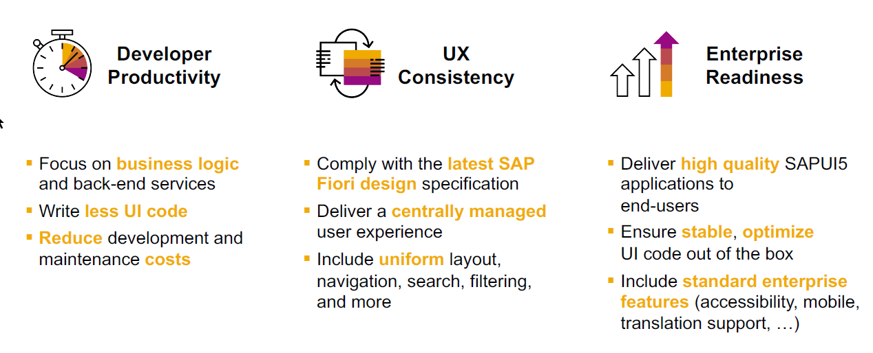
SAP Fiori elements boosts SAP Fiori development efficiency
www.anubhavtrainings.com

Slide 12

SAP Fiori elements prioritizes efficiency over flexibility
www.anubhavtrainings.com

Slide 13


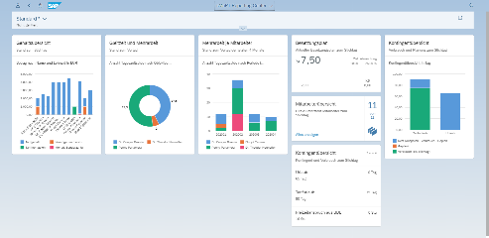





Developer Persona – Fiori Elements
Anubhav
Happy User
Rob
S/4HANA Technical consultant
ABAP Developer
Roxana
UX Designer | Fiori Developer
ABAP Dev. Tools
On
Eclipse
VS Code
BAS
OData Service
Fiori Elements Project
Annotations.xml
CDS Views
MDE
@
www.anubhavtrainings.com

Slide 14
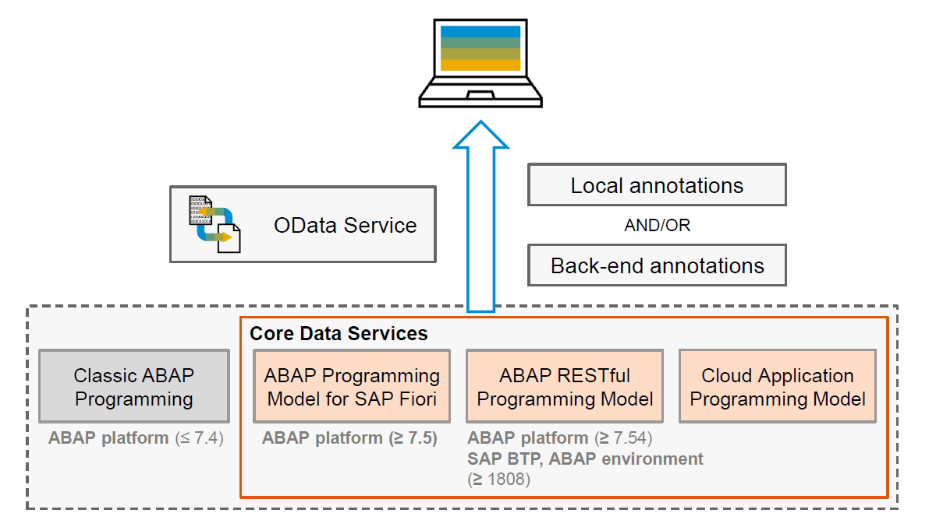
Big Picture – Architecture
www.anubhavtrainings.com

Slide 15
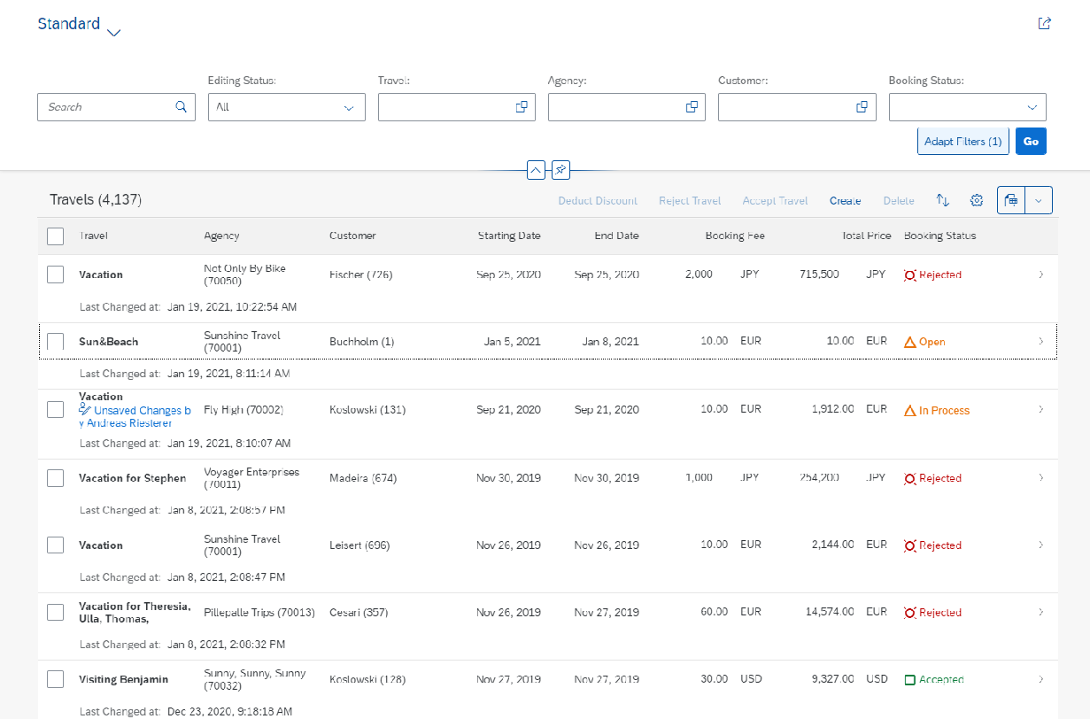
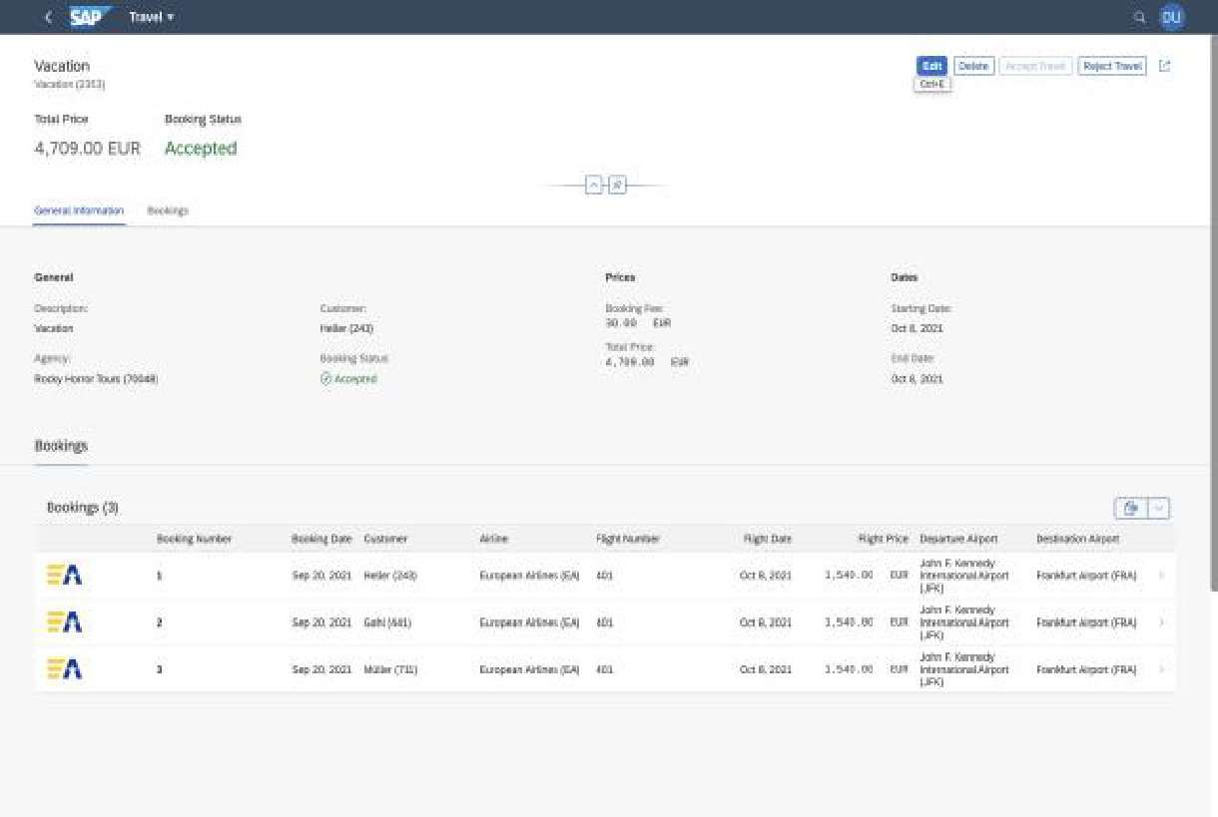
Fiori Elements - List Report Application
The list report offers powerful features for finding and acting on relevant data sets. It is often used as an entry point for navigating to the item details, which are usually shown on an object page.
List Report
Object Page
www.anubhavtrainings.com

Slide 16






Slide 17





























Slide 18
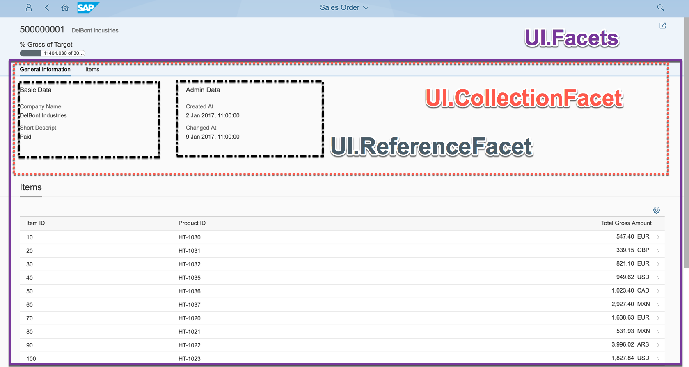
Object Page
www.anubhavtrainings.com

Slide 19
www.anubhavtrainings.com
Thank You
End of Day 5
www.anubhavtrainings.com

Slide 20


We’re committed to empower you to be
#FutureReady
through powerful training solutions.
We build the workforce of the future.
250+
Corporate Clients
30,000+
Learners Trained
25000+
Learners Placed
FREE WEBINARS
Sign up for free webinars with industry experts every fortnight!
Enroll Now!
Contact us today!
https://anubhavtrainings.com

